Slide 1
Ethics in Big Data Analytics
DAMA Philly | September 2017

Slide 2
Agenda
What are Ethics?
Need for Ethics in Big Data Analytics
How is Data Different?
Ethical Challenges in Big Data World
Future of Ethics

Slide 3

What are Ethics?

Slide 4
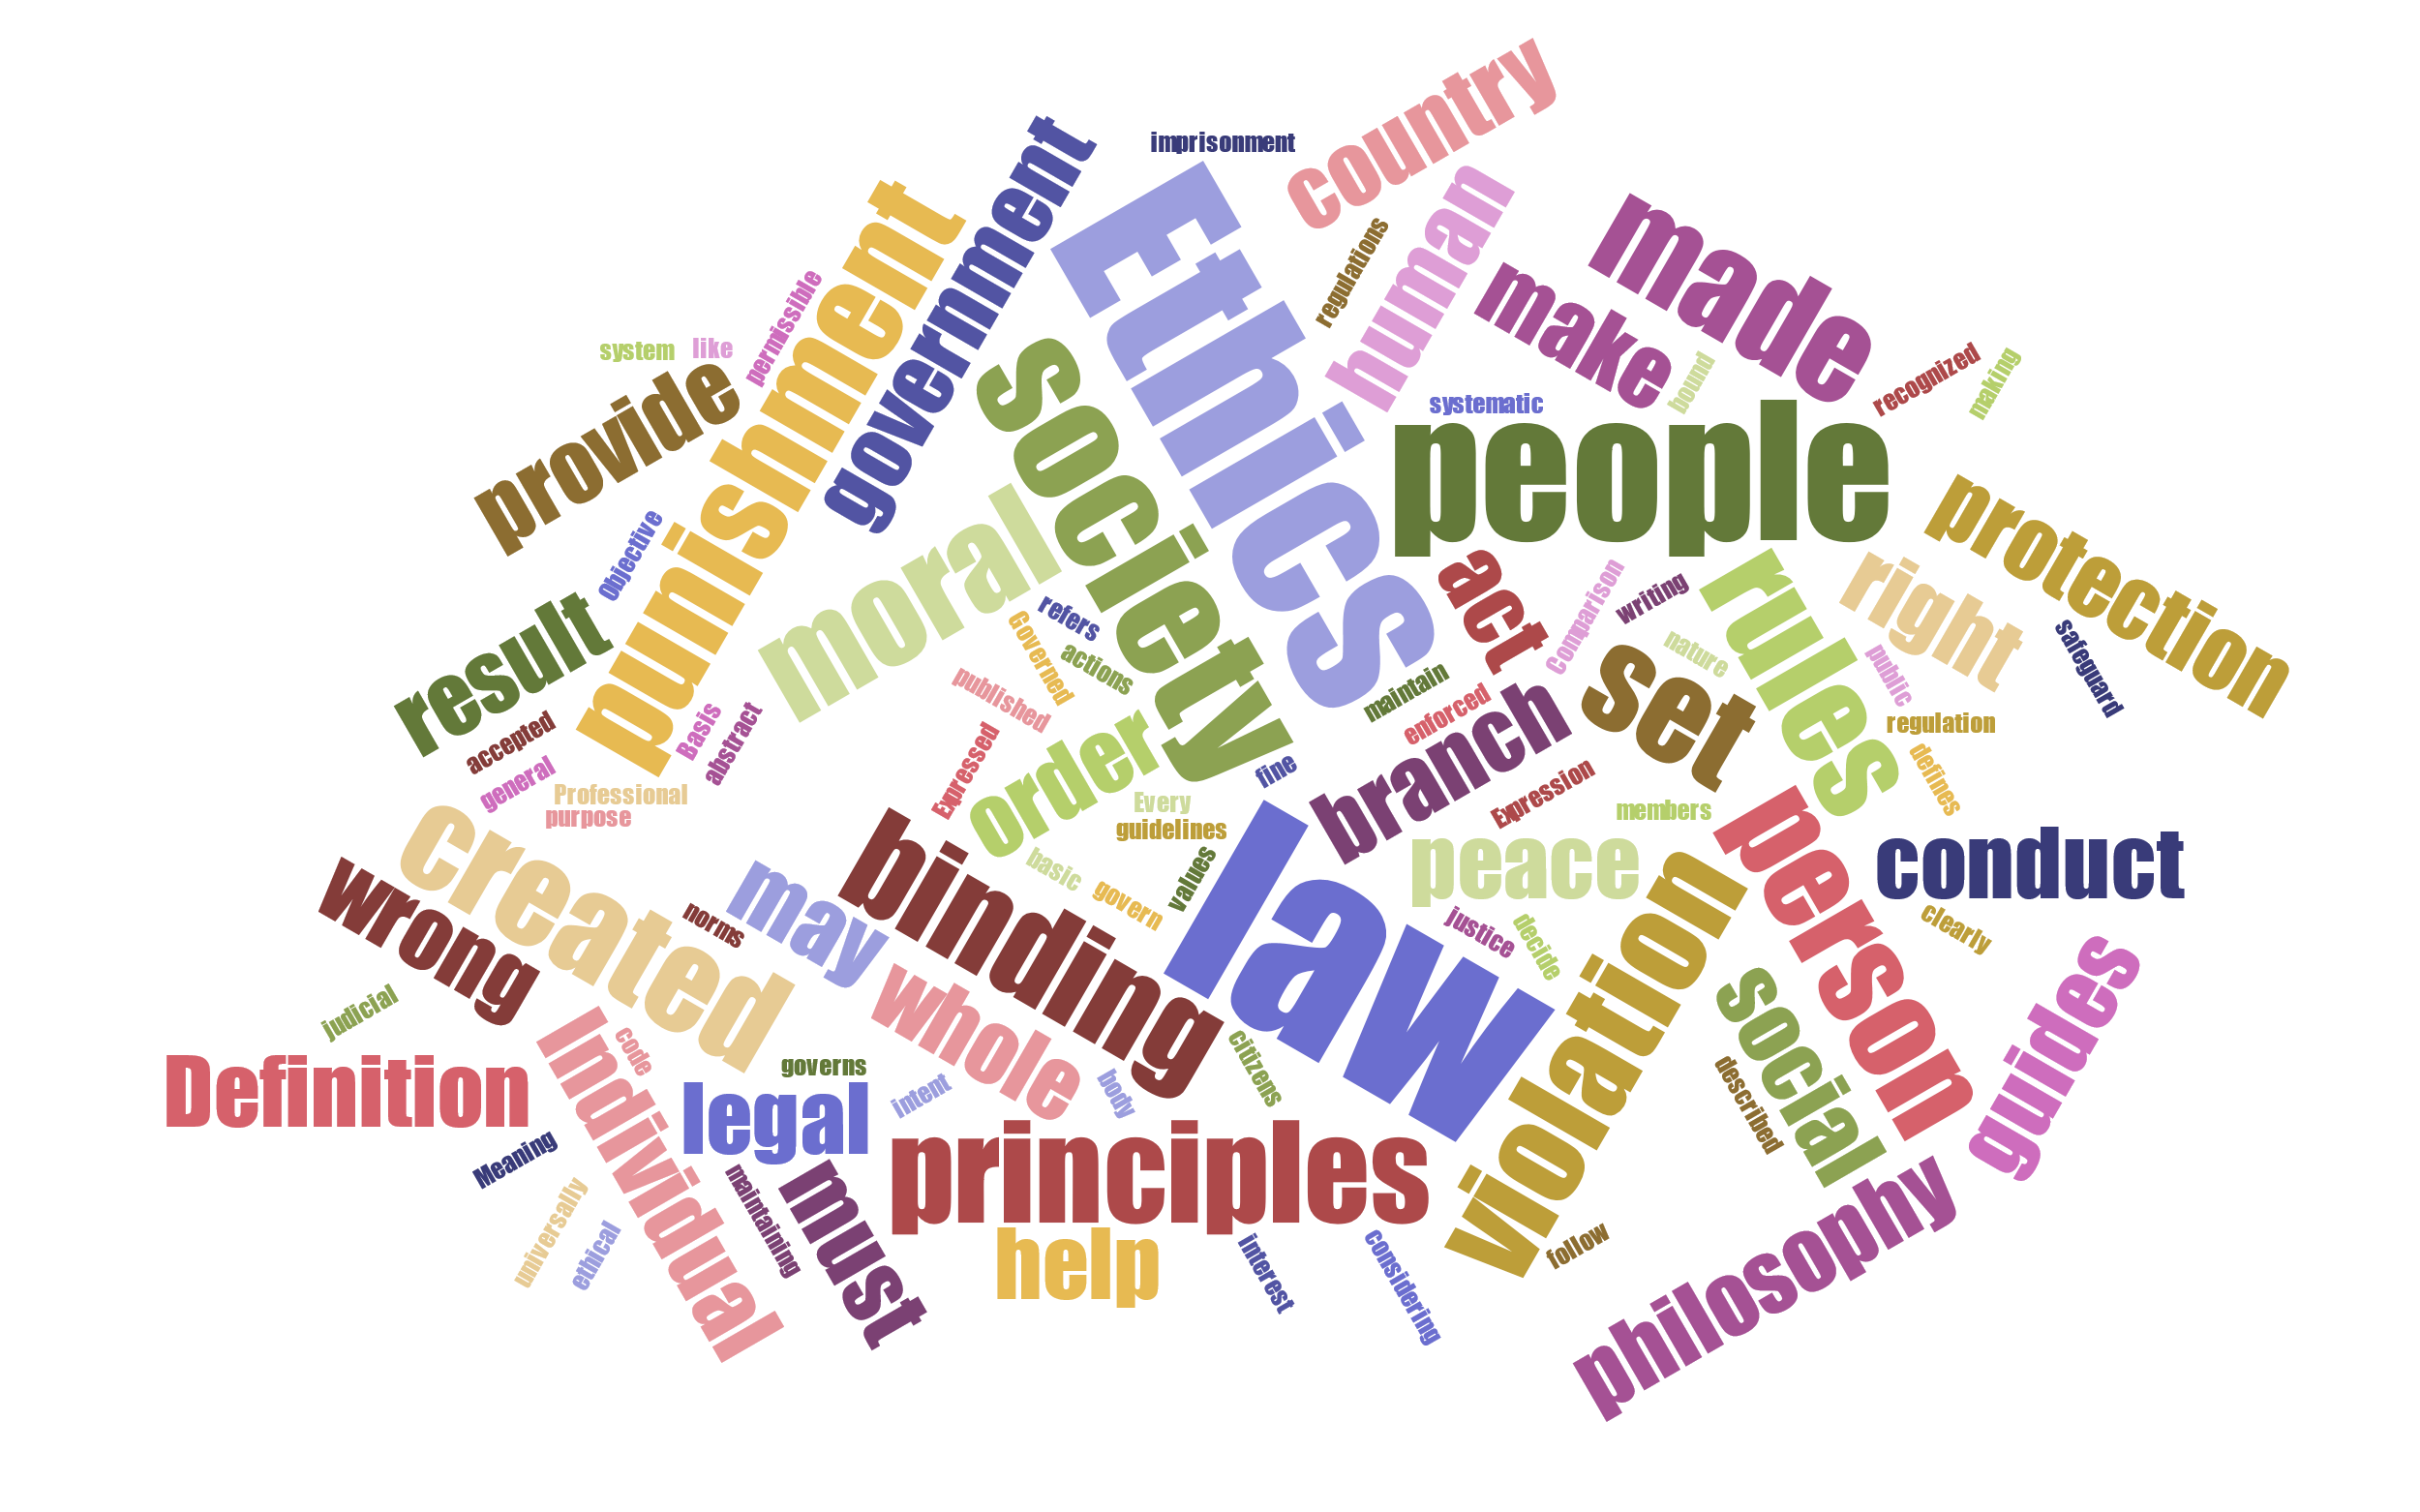
Terms

Slide 5
Legal vs. Ethical
Legal | Ethical
Rule | Guideline
Must Follow | Free to Follow
Country or State | Religion, Culture, Society, Beliefs
Crime | Immoral
Fairly well defined | Abstract
Established procedures to analyze violations | No standards or procedures to analyze violations
Standard punishment for violations | Hard to punish offenders

Slide 6
Legal vs. Ethical
Legal
Targeted Ads with Discriminatory Intent
Protect the privacy of the customers
Ethical
Sell email address of customers without their permission
Leak Information about the employer to stop an illegal activity

Slide 7
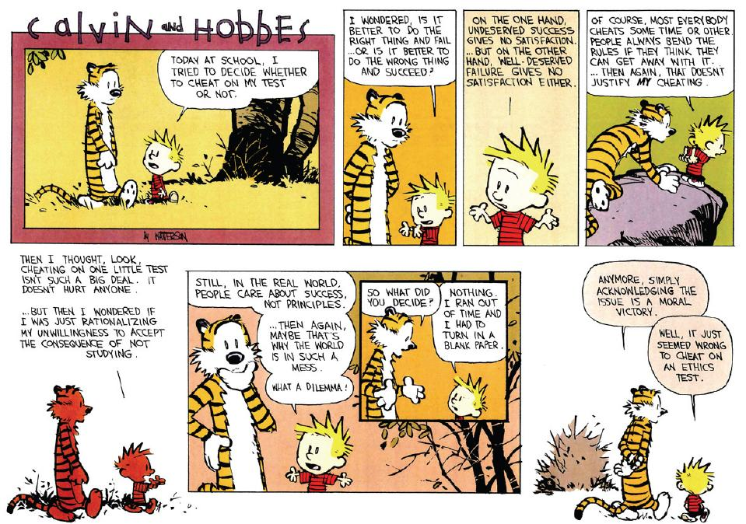
Choices and Dilemma

Slide 8
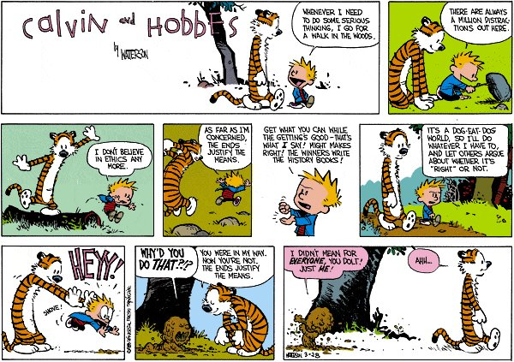
Reciprocity - The Golden Rule

Slide 9
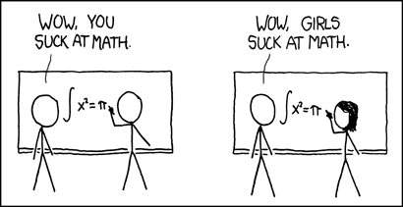
Breaking Bias
Source: https://www.xkcd.com/385/

Slide 10

Ain’t Got Nothing to Hide
When you say, ‘I have nothing to hide,’ you’re saying, ‘I don’t care about this right.’ … The way rights work is, the government has to justify its intrusion into your rights.
~ Edward Snowden

Slide 11
Need for Ethics in Big Data Analytics

Slide 12
Why Ethics?
“Man prefers to believe what he prefers to be true” ~ Novum Organum; Or, True Suggestions for the Interpretation of Nature by Bacon
“There are several species of impositions that have been practiced in science, which are but little known, except to the initiated, and which it may perhaps be possible to render quite intelligible to ordinary understandings. These may be classed under the heads of hoaxing, forging, trimming, and cooking.” ~ Reflections on the Decline of Science in England, and on Some of Its Causes by Charles Babbage

Slide 13
Why Ethics?
Inconsistent, invalid, incorrect, irrelevant data, wrong data model, poorly designed algorithms, misinterpreting results – anyone or all of these can lead to failure of big data projects
Gartner predicts that, through 2017, 60 percent of big data projects will fail to go beyond piloting and experimentation, and will be abandoned
Gartner also predicts that, by 2018, 50 percent of business ethics violations will occur through improper use of big data analytics

Slide 14
Potential Causes of Failure in Big Data Projects
Collect
Poor Data Entry
Duplicates
Prepare
Aggregation
Correlation
Analyze
Visualize
Share
Inconsistency
Sample Bias
Privacy Provisions
Poor problem definition
Bad design
Inaccurate data model
Biased algorithms
Lack of understanding
Inconsistent representation
Security Levels
Unauthorized Access
Legal Conflicts

Slide 15
Ethical Implications
Loss of Trust
Inefficient use of Resources
Damages Brand Reputation
Builds Liabilities
Legal Sanctions
Serious Harm

Slide 16
Ethical Challenges in Big Data World

Slide 17
Informed Consent
Problem Statement
Primum non nocere
If any research is conducted on a human subject, then this human subject must be informed about the experiment, must consent to the experiment voluntarily, without any coercion, and must have the right to withdraw consent at any time.
Legal
Belmont Report of 1979 – National Commission for the Protection of Human Subjects of Biomedical and Behavioral Research
Common Rule of 1991 – Federal Policy for the Protection of Human Rights
Institutional Review Board
Case Study: Facebook Filter Bubble Study May 2015
“Filter bubble” — the personalized universe of information that makes it into our feed
29% of any person’s news feed content contained contrary opinions also called “cross-cutting” articles
Facebook effectively hides 1 in 20 “cross-cutting” links if you are a self-identified conservative, and it hides 1 in 13 “cross-cutting” links if you identify as a liberal.

Slide 18
Data Ownership
Problem Statement
Data is the new asset
A data governance process that details an organization's legal ownership of enterprise-wide data
Defines the data owner’s ability to assign, share or surrender all of these privileges to a third party
Legal
Copyrights
Intellectual Property Rights
Terms of Service - Own your content, but we get the right to use it in various ways; or we own your content, but we give you some rights over how you can still use it
Case Study: RadioShack selling customer data after filing bankruptcy in February 2015
13 million e-mail addresses and 67 million customer names and physical addresses -- as well as potential information about customers shopping habits
All versions of RadioShack’s privacy policy contained provisions that consumer PII would not be sold
Limit the sale of the PII so that it would not sell, customer’s that were active more than two years prior to the petition date and that customer’s active within the two-year period prior to the petition dates would receive an opportunity to opt-out

Slide 19
Data Privacy
Problem Statement
Appropriate use of data – when the data is entrusted, it should be used only for the agreed purposes
Three levels – Public, Protected, Private
Legal
Right to be left alone – Louis Brandeis and Samuel Warren in 1890
Health Insurance Portability and Accountability Act (HIPAA), Financial Services Modernization Act (GLB), Final Rule on Privacy of Consumer Financial Information, Fair Credit Reporting Act (FCRA), Fair Debt Collection Practices Act (FDCPA), Driver's Privacy Protection Act (DPPA)
Case Study : Carpenter v. United States in June 2017
Carpenter and his codefendant has been convicted in a series of robberies with the help of FBI obtaining Cell Site Location Information or CSLI without a warrant
Verizon and AT&T alone received about 125,000 requests for CSLI – and each request may involve months of information on multiple people

Slide 20
Anonymity
Problem Statement
Social embarrassment - shame, stigmatization
Damage to social and economic status - loss of employment and health insurances
Serious mental or physical harm - stalking and attacking
Legal
Safe Harbor – statute or a regulation that specifies that certain conduct will be deemed not to violate a given rule – results in the removal or generalization of 18 elements from data
Expert Determination - risk-based approach to de-identification that applies current standards and best practices from the research to determine the likelihood that a person could be identified
Case Study: Doe v. Netflix in December 2009
Netflix announced a competition with two massive datasets with 480,000 de-identified customer information along with 100 million movie ratings info from IMDB, contestants had to come up with a recommendation algorithm
Information was re-identified and ousted a lesbian mother
Law suit alleges that Netflix violated fair-trade laws and a federal privacy law protecting video rental records, when it launched its popular contest in September 2006 – eventually settled for $9 million

Slide 21
Algorithmic Bias
Problem Statement
Are algorithms subjective?
Causes – bad data, poor design, assuming correlation implies causation, complexity, trade secrets, IPR
Machine learning and AI learns and adapts from human behavior
Legal
Title VII of the Civil Rights Act of 1964 prohibits discrimination in employment on the basis of race, color, sex, or ethnic origin
Age Discrimination in Employment Act (ADEA)
Americans with Disabilities Act (ADA)
Equal Employment Opportunity Act of 1972
Case Study – Targeted Ads
Harvard Study Google searches of names “racially associated” with the black community are 25% more likely to yield sponsored ads suggesting that the person has a criminal record, regardless of the truth
FTC says advertisers are able to target people who live in low-income neighborhoods with high-interest loans
Carnegie Mellon study says Google showed an ad for a career coaching service advertising “$200k+” executive positions 1,852 times to men and 318 times to women

Slide 22
Digital Forensics
Problem Statement
Use of science and technology used in connection with the detection of crime and establish facts in courts of law.
Capabilities granted to law enforcement not provided to ordinary users – NSA’s Prism
Who bells the cat?
Legal
Electronic Communications Privacy Act (ECPA) of 1986
The Wiretap Statute (Title III) amended 1986
The Pen/Trap Statute amended 2001
The USA PATRIOT Act 0f 2001
Case Study : Apple v. FBI of 2016
Custom access to an iPhone used by one of the two terrorists who killed 14 people in San Bernardino
FBI struggled to access information on the iPhone because the phone is encrypted using the owner's personal passcode
Wants Apple to help create a backdoor that would potentially allow the government to access phones without the owner’s authorization or knowledge

Slide 23
Data Leaks
Problem Statement
Who is going to access your data and how?
Big Data processing assumes consolidation of disparate data sources to unified data lake albeit physically distributed
Legal
California data breach notification law of 2002
Forty-eight states, the District of Columbia, Guam, Puerto Rico and the Virgin have data breach notification laws
Case Study – Anthem Data Breach of 2015
Nearly 80 million records, including personal information such as names, Social Security numbers, dates of birth, and other sensitive details
Settled the class action lawsuit for data breach for a record $115 million

Slide 24
Data Storage
Problem Statement
Where are you going to store data and how?
Right to Forget
Data disposal
Legal
At least 31 states and Puerto Rico have enacted laws that require entities to destroy, dispose, or otherwise make personal information unreadable or undecipherable.
Out of which Alaska laws only applies to paper records, other states have laws that only apply to employers and not government
Federal Trade Commission's Disposal Rule
Case Study - Voter Fraud Commission of 2017
Store voter roll data from all 50 states on White House computers
Half a dozen law suits – two of them are Electronic Privacy Information Center alleging that "the Commission's demand for detailed voter histories also violates millions of Americans' constitutional right to privacy. A suit by the American Civil Liberties Union alleging that the commission is failing to comply with federal transparency and open-meeting laws

Slide 25
Future of Ethics in Big Data Analytics

Slide 26
Code of Ethics
Organization | Documentation
IEEE | Ethics and Member Conduct
ACM | ACM Code of Ethics and Professional Conduct
British Computer Society | Code of Conduct for BCS Members
Data Science Association | Data Science Code of Professional Conduct
INFORMS for the Certified Analytics Professional | Code of Ethics for Certified Analytics Professionals
American Statistical Association | Ethical Guidelines for Statistical Practice
Digital Forensics Certification Board | Code of Ethics and Standards of Professional Conduct

Slide 27
Points to Ponder
Consider the impacts of data analysis on human lives
Understand the influence of our values on our actions
Leave emotion out when you sit in for discussion
Listen to all sides and achieve consensus
Develop common set of values that are acceptable to everyone
With great power comes great responsibility!

Slide 28
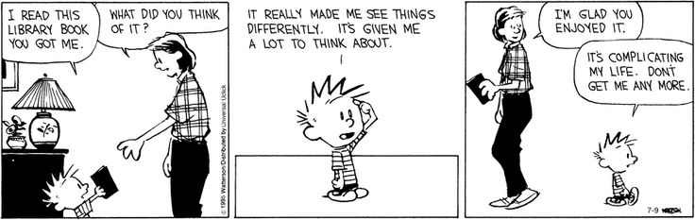
Ethics

Slide 29

Mercy Beckham
Solutions Architect
mbeckham@captechconsulting.com

